Slide 1
Bad Novelists
Text to Motion Generation
Members:任政 孙中川 熊军睿 杨磊 谢一帆

Slide 2
Content
Division of Labor
Motion visualization
Text to motion
Project overview
Demo presentation

Slide 3
Division of Labor
任 政: Text to motion model , model stylization , leader
孙中川: Text to motion model , model training , model evaluation
熊军睿: Motion visualization
杨 磊: Character modeling , Motion visualization
谢一帆: Paper , application discussion
单击添加标题

Slide 4
Project overview
Overview：
Our project aims to develop a framework that generates character motion videos from text, creating diverse and stylized motion sequences mapped onto the SMPL model for highly realistic 3D visualization in a Unity environment. This way, users can have an intuitive and interactive experience, seamlessly creating character motion videos in Unity using text.
单击添加标题
Text
Joint data process
Unity Visualization
Motionclip reproduction
Key words：
Character Motion Modeling 、SMPL Model 、Text - Driven Generation 、Motion Synthesis

Slide 5
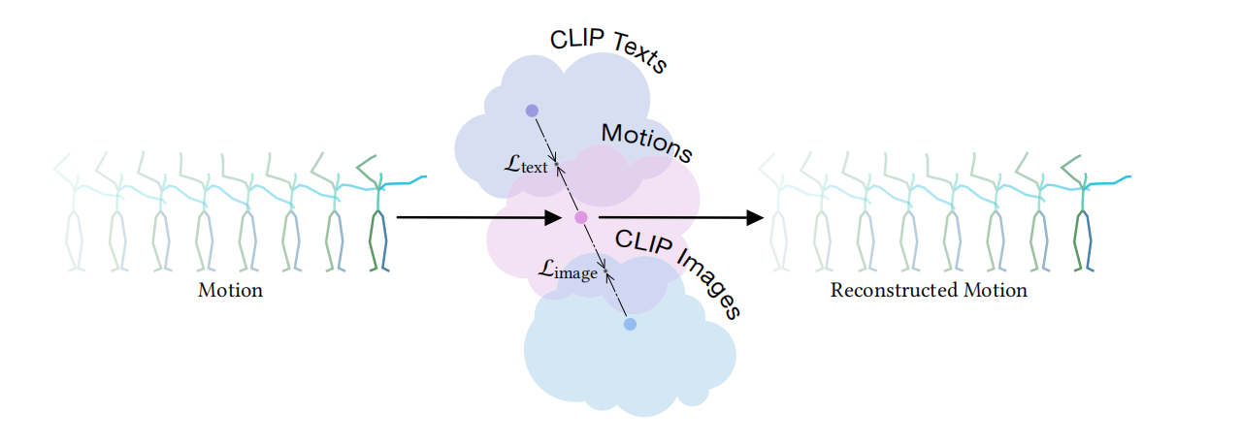
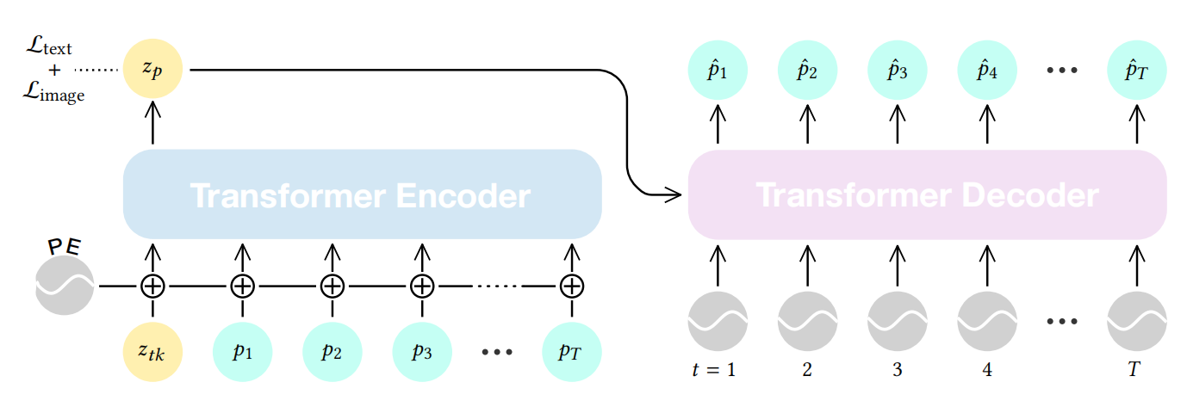
Text to Motion
Process：
Clip : a model developed by OpenAI understanding the relationship between images and text.
Specific Process:
1.Text Encoding:
The input text description is processed by the text encoder of the CLIP to generate a vector in the latent space. This vector contains the semantic information of the text.
2.Latent Space Alignment:
The latent space of the Motion Autoencoder is aligned with the latent space of the CLIP .
3.Motion Decoding:
Aligned latent space vectors are passed through the decoder of the Motion Autoencoder to generate the corresponding motion sequence. This motion sequence contains information for each joint at each time step.

Slide 6
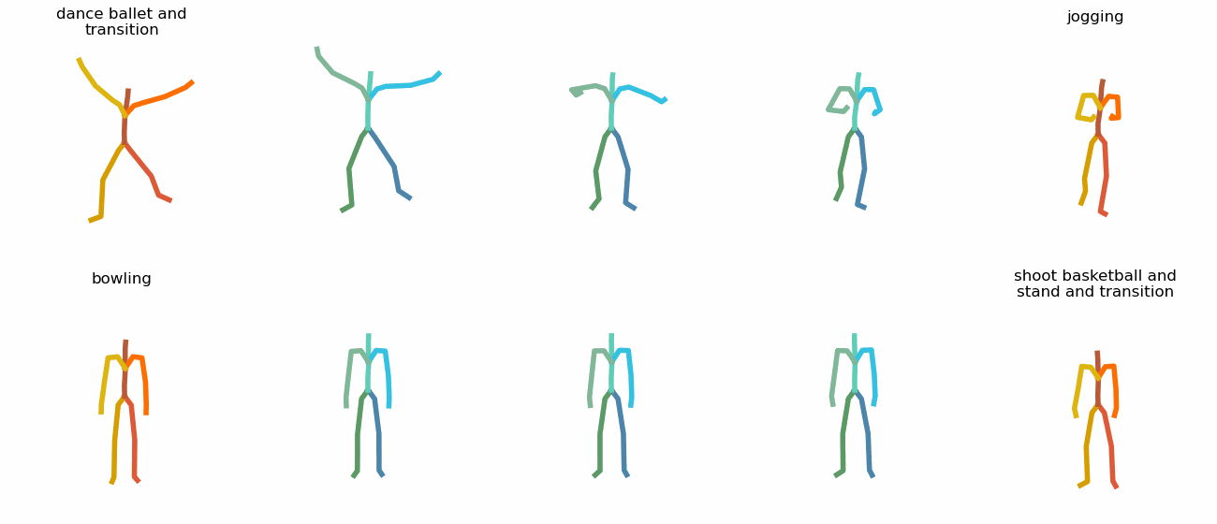
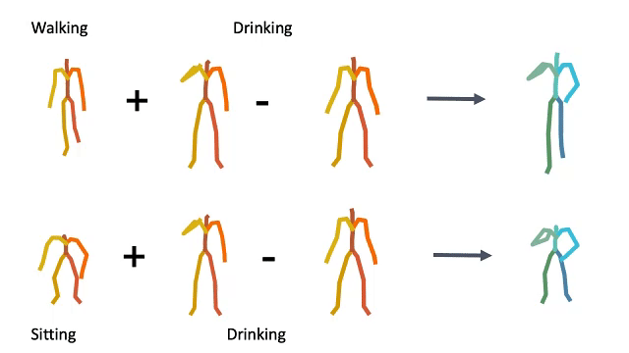
Text to Motion
stylization
Style generation and Abstract language:
Interpolation:
Latent Edit:
1.Two latent codes yields sematic transitions between motions on time and space
2.Smoothness ——> the targets :three transitions evenly sampled from the linear trajectory
latent space arithmetic to edit motion: motion compositionality
eg:the upper body action can be decomposed from the lower body one, and recomposed with another lower body performance.

Slide 7
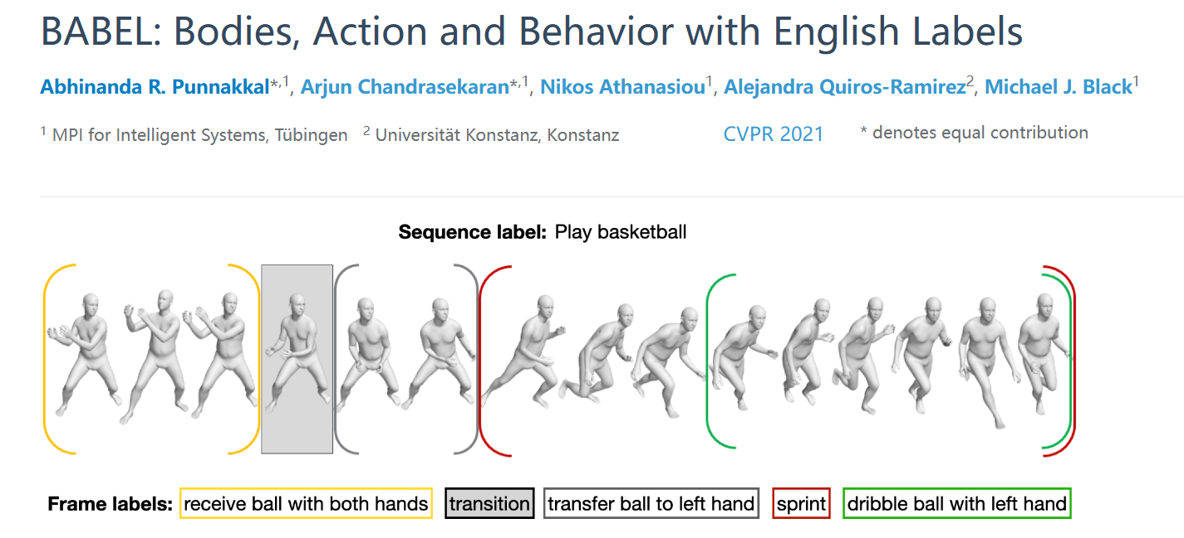
Text to Motion
Training：
Data Preparation:
Use action datasets with text descriptions: KIT dataset and BABEL dataset. [Motion sequences and their corresponding text descriptions.]
somthing wrong: When I increase the number of time I traverse the data set to 500, I find that out put motion becomes stationary.
Joint Training:
Simultaneously train the Motion Autoencoder and the CLIP model to align their latent spaces. Alignment is achieved by minimizing the distance between the latent representations of text and the motion sequences.
Loss function: motion reconstruction loss (ensuring that the decoded motion sequence matches the real motion sequence) and the alignment loss (ensuring that the representations of text and motion are close in the latent space).

Slide 8
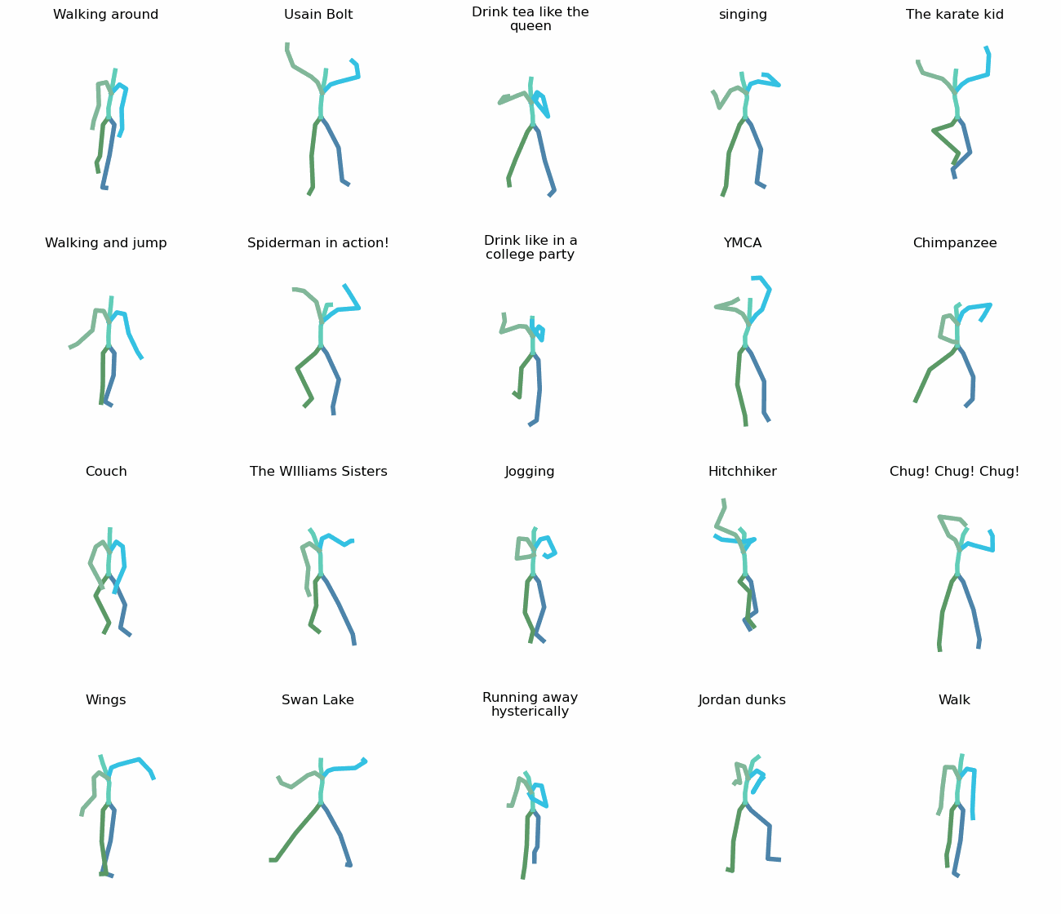
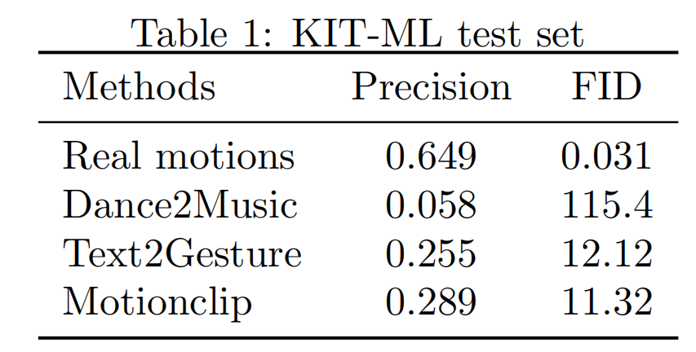
Text to Motion
Evaluation
We compared our output result on the KIT dataset with real motions, Dance2motion, and Text2Gesture.
Metrics: FID: Using a pre-trained motion encoder, the performance of the generative model is measured by comparing the distance between the generated motion and the real motion.
Precision:For each pair of generated sequences and description texts, 31 other prompts are randomly selected from the test set. The average precision is calculated using a pre-trained contrastive model.

Slide 9
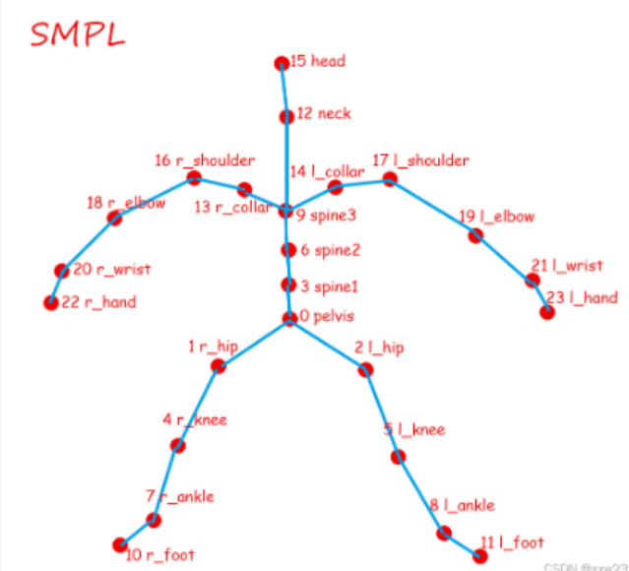
Text to Motion
Position To Rotation
Because the motion GIFs are drawn based on joint coordinate information, but in Unity the SMPL model requires joint rotation angles.So it is necessary to convert the position information into rotation information.
kinematic chains
We can use kinematic chains to understand the dependencies between joints, and thereby obtain the vector information of each joint. So, we can get the desired rotation information by converting these vectors into joint Euler angles or quaternions.
Left leg: 0,1,4,7,10
Right leg: 0,2,5,8,11
Left arm: 9,13,16,18,20,22
Right arm: 9,14,17,19,21,23
Torso: 0,3,6,9,14,12,15

Slide 10
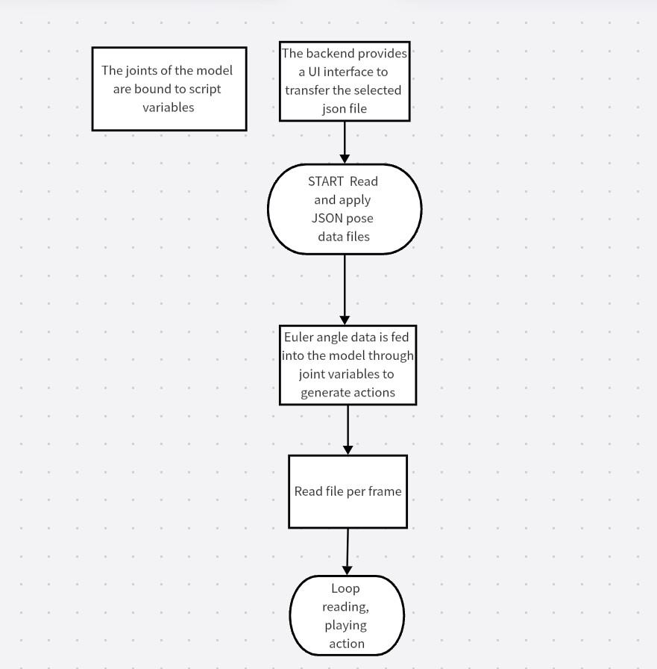
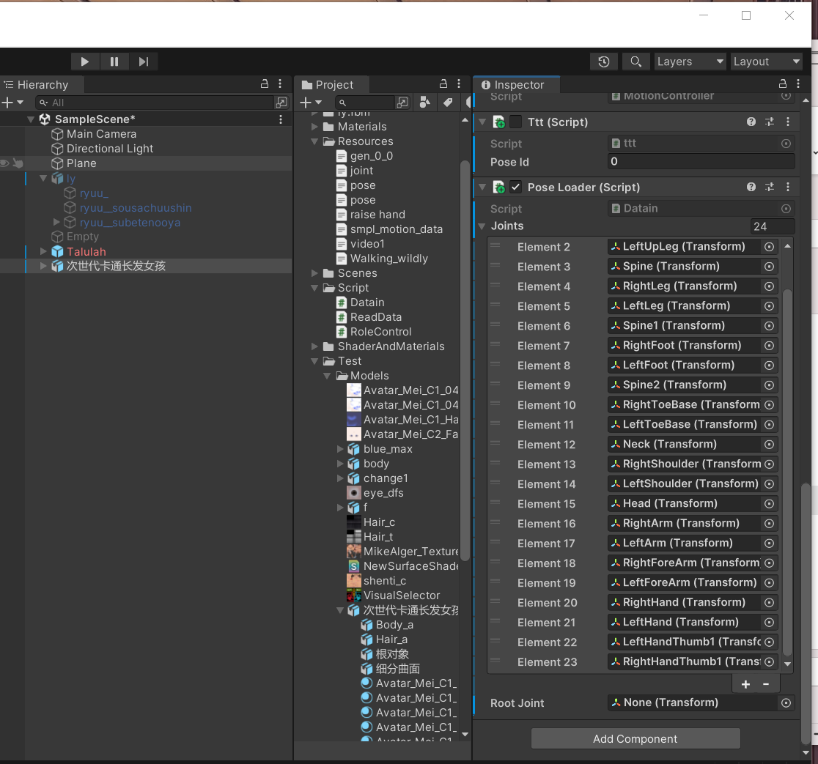
Motion Visualization
Overview
Key Process
1.the joints of the model are bound by adding elements that correspond to the 24 joints of the model, and these elements are bound to public variables.

Slide 11
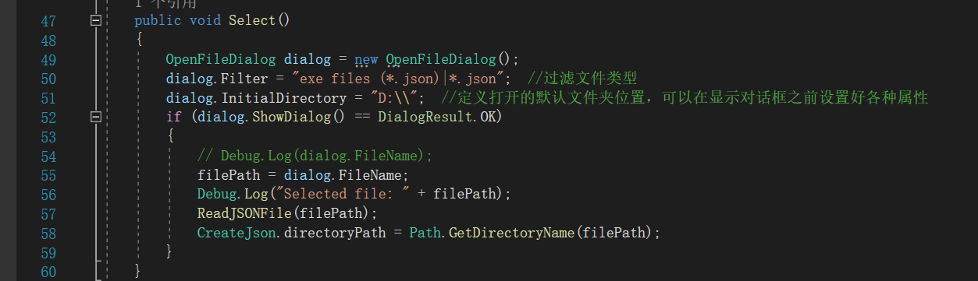
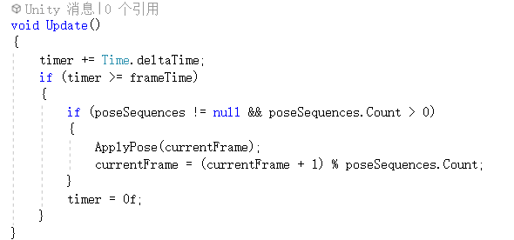
Motion Visualization
Key Process
2.Search local files and read the JSON file
3.Read each frame continuously and apply the applyPose function to demonstrate the motion.

Slide 12
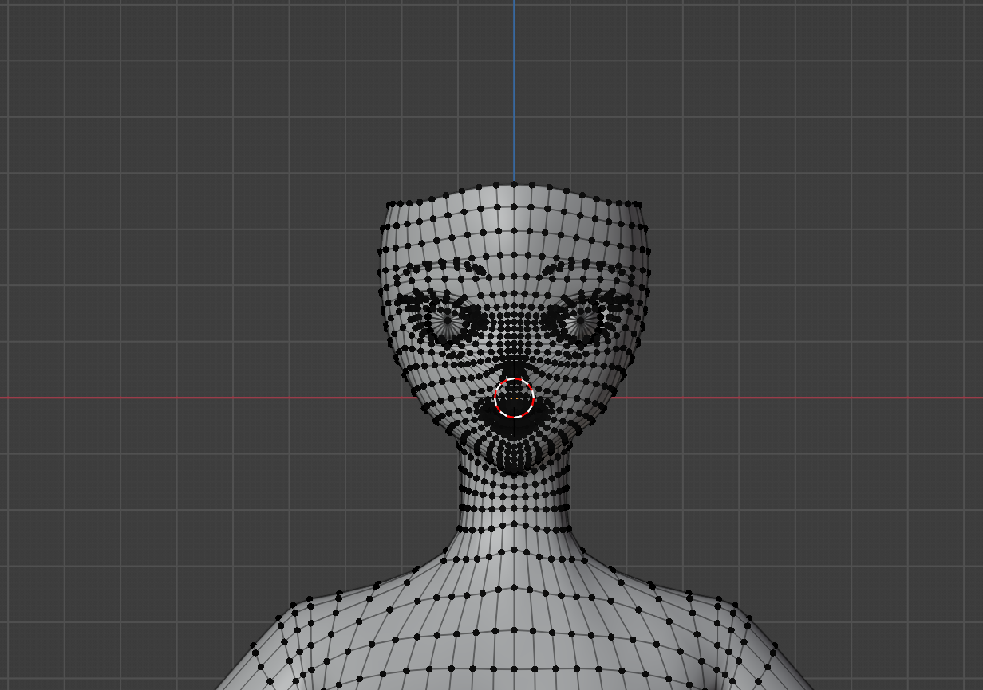
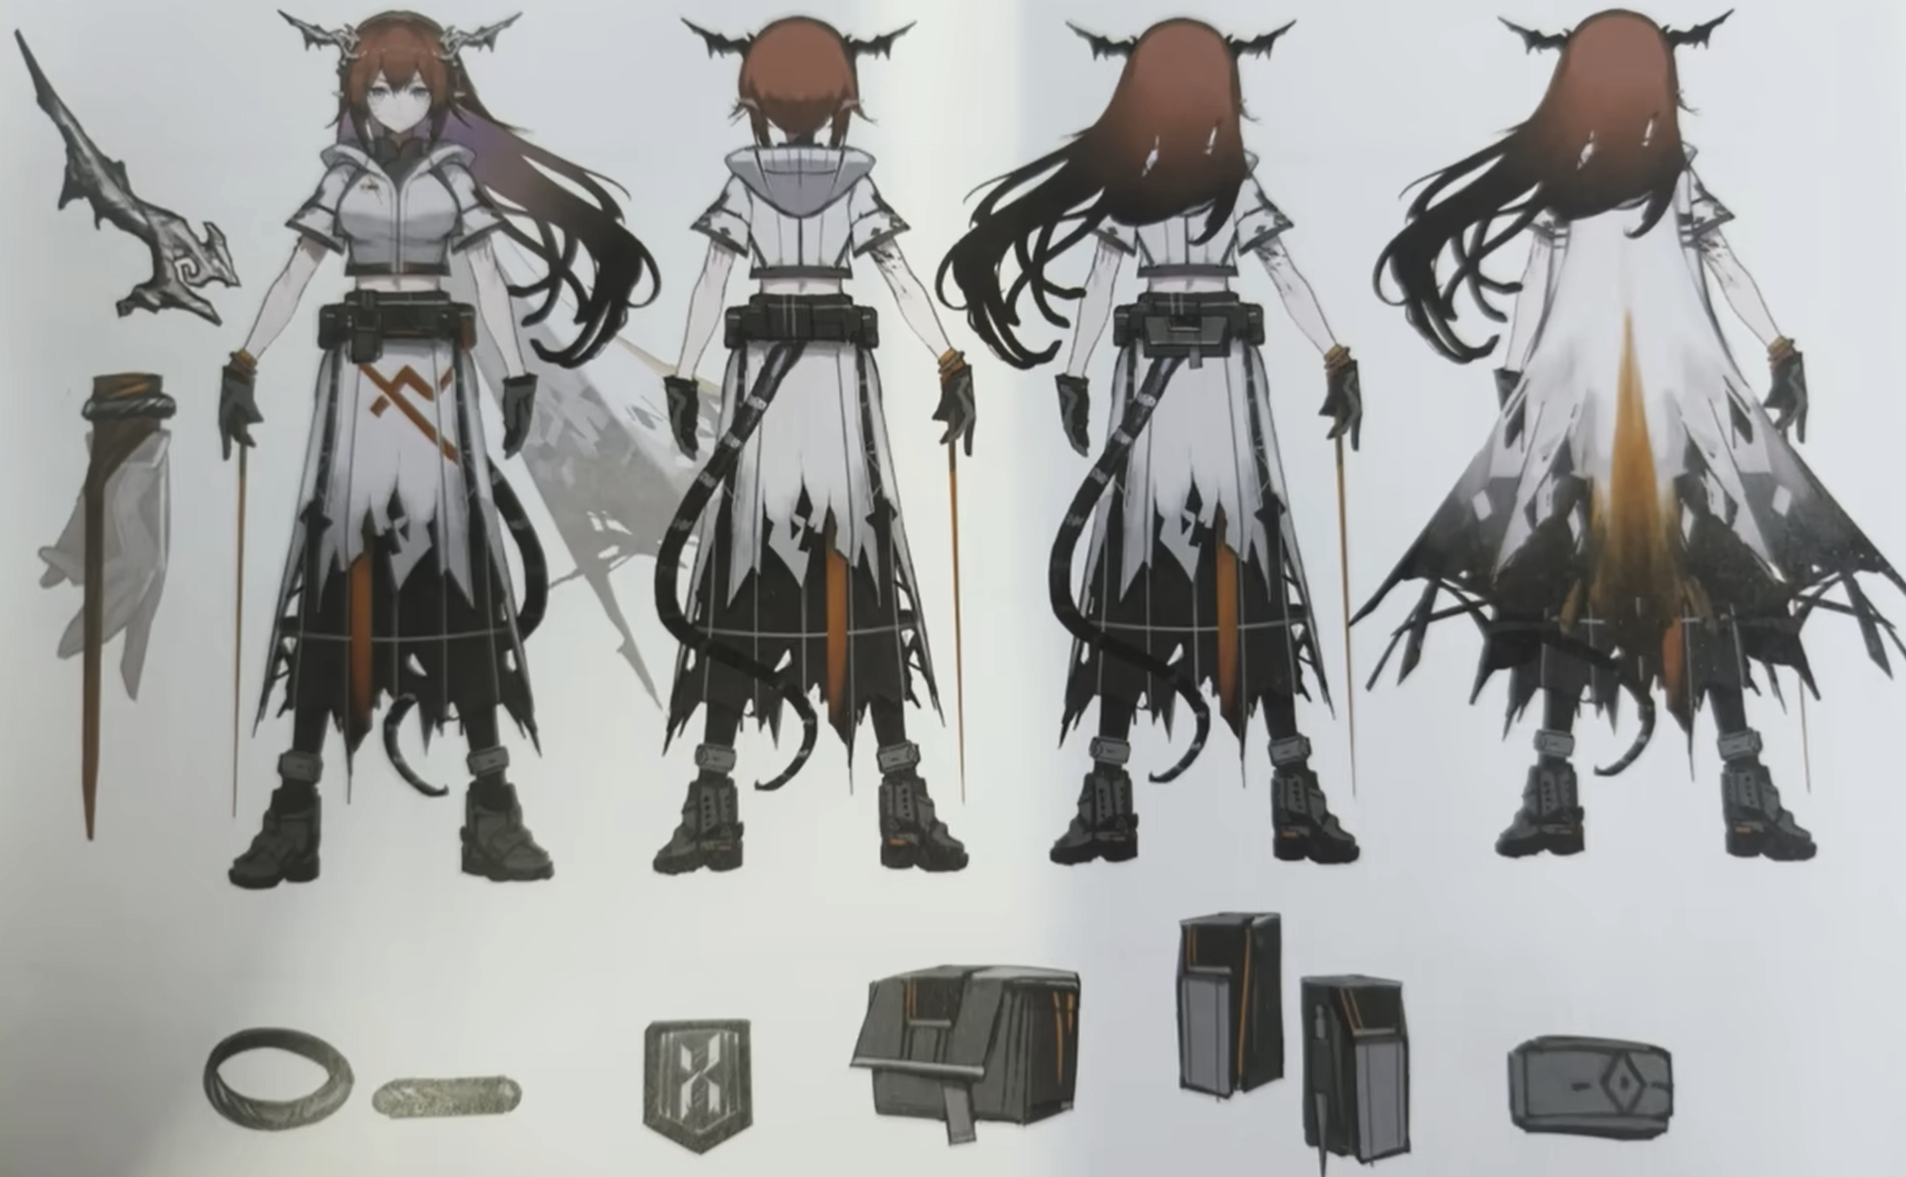
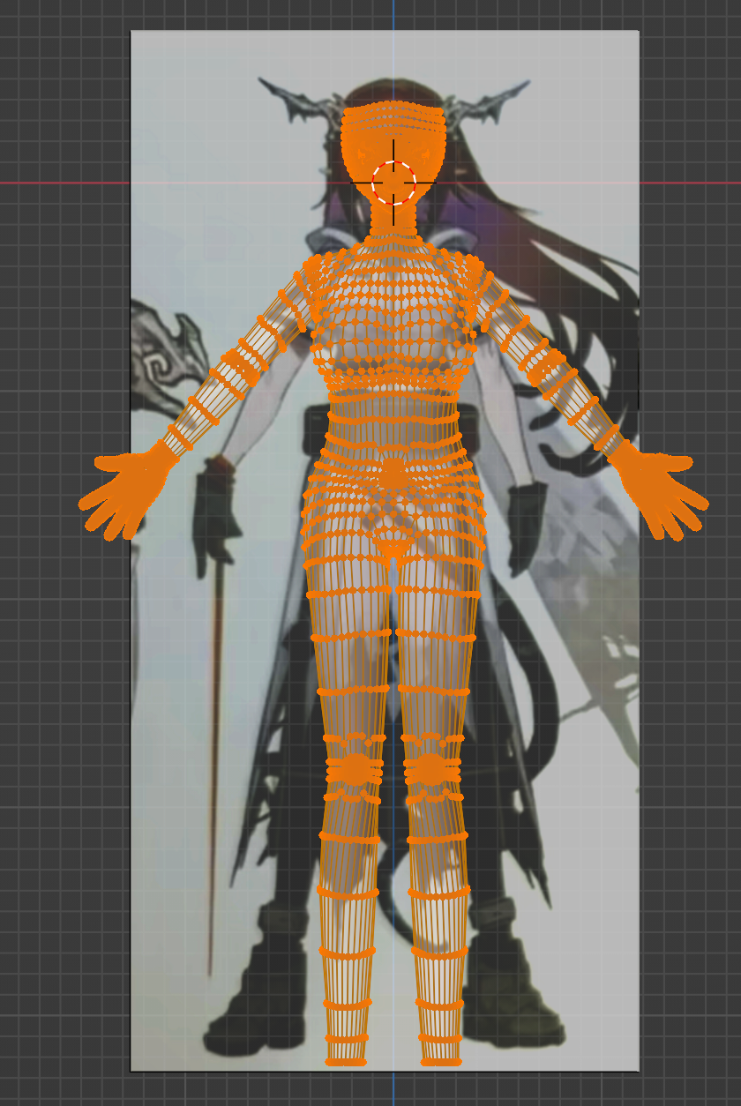
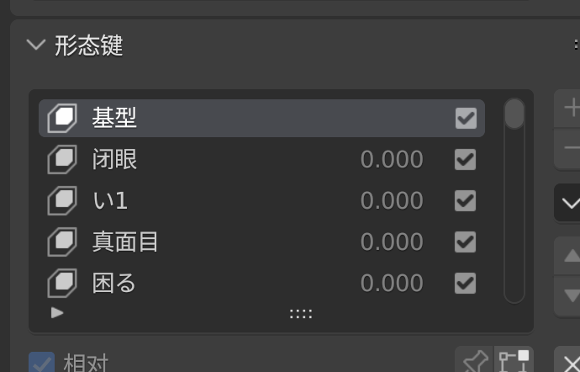
Motion Visualization
Use blendshapes to handle facial expressions. Some morph targets are recreated from the reference model by using lattice deformation to match the current model's surface with the reference model's surface, then transferring the morph targets using a plugin. The remaining morph targets are created manually.
Character modeling
SMPL is a realistic human shape and pose learning model , allows animators to control it, and can be used for research purposes.The goal is to create realistic animated human bodies.
In our project, during the modeling process, we provide a human body model that can apply the SMPL scheme through skeletal binding and blendshapes.
Key Process
Create the human body based on reference images
Search for character design sketches

Slide 13
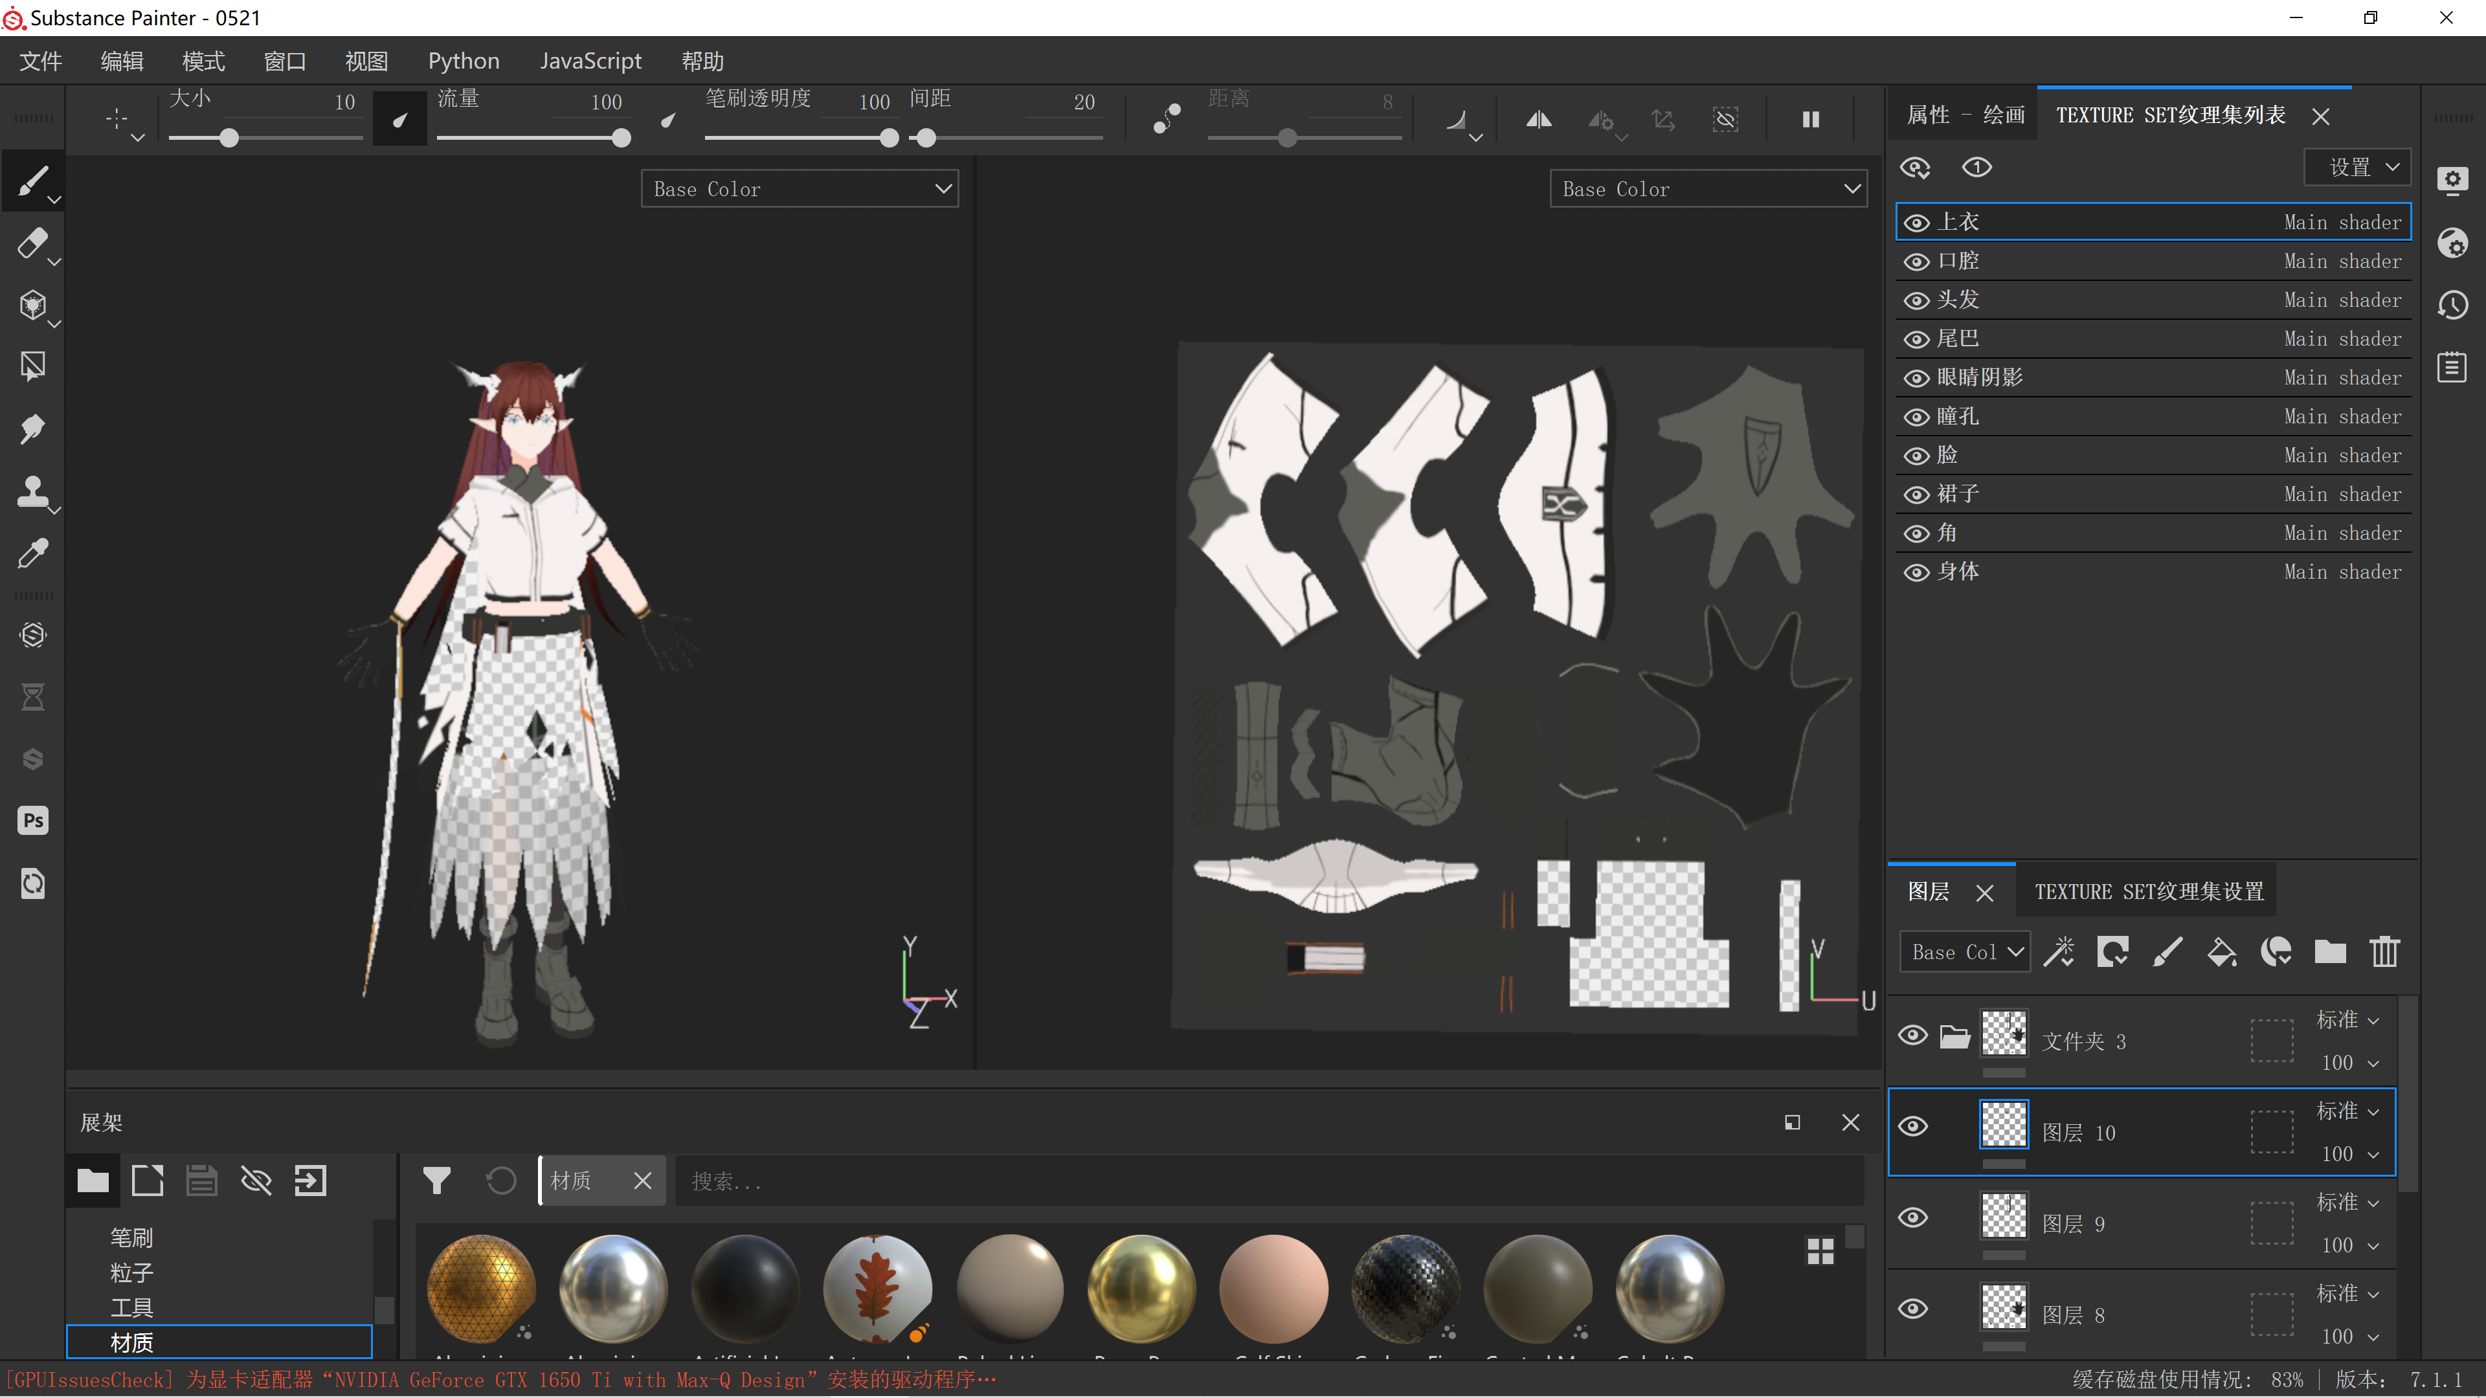
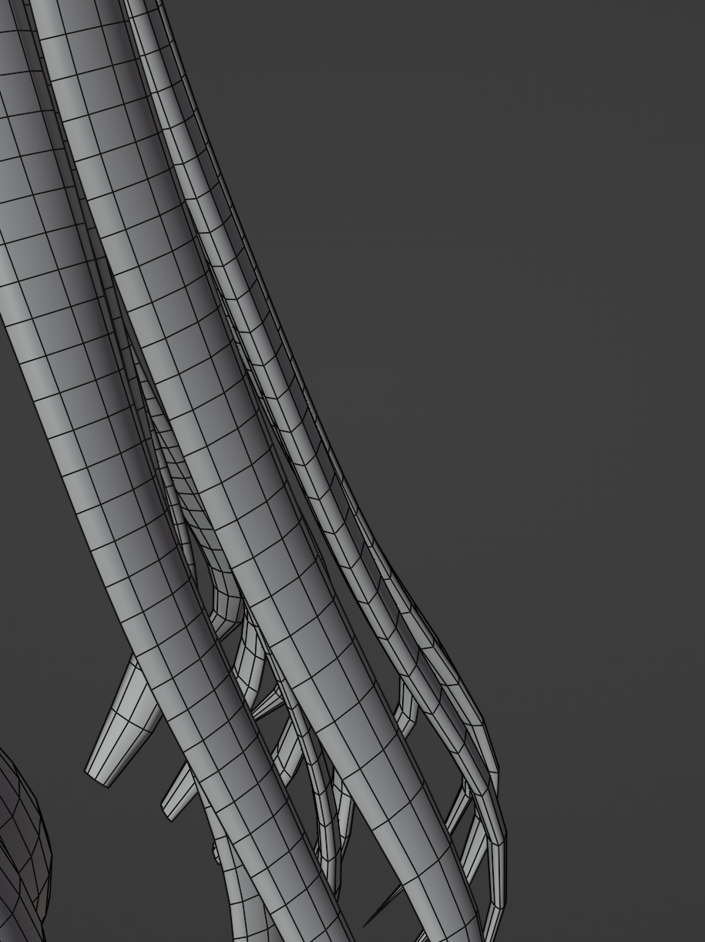
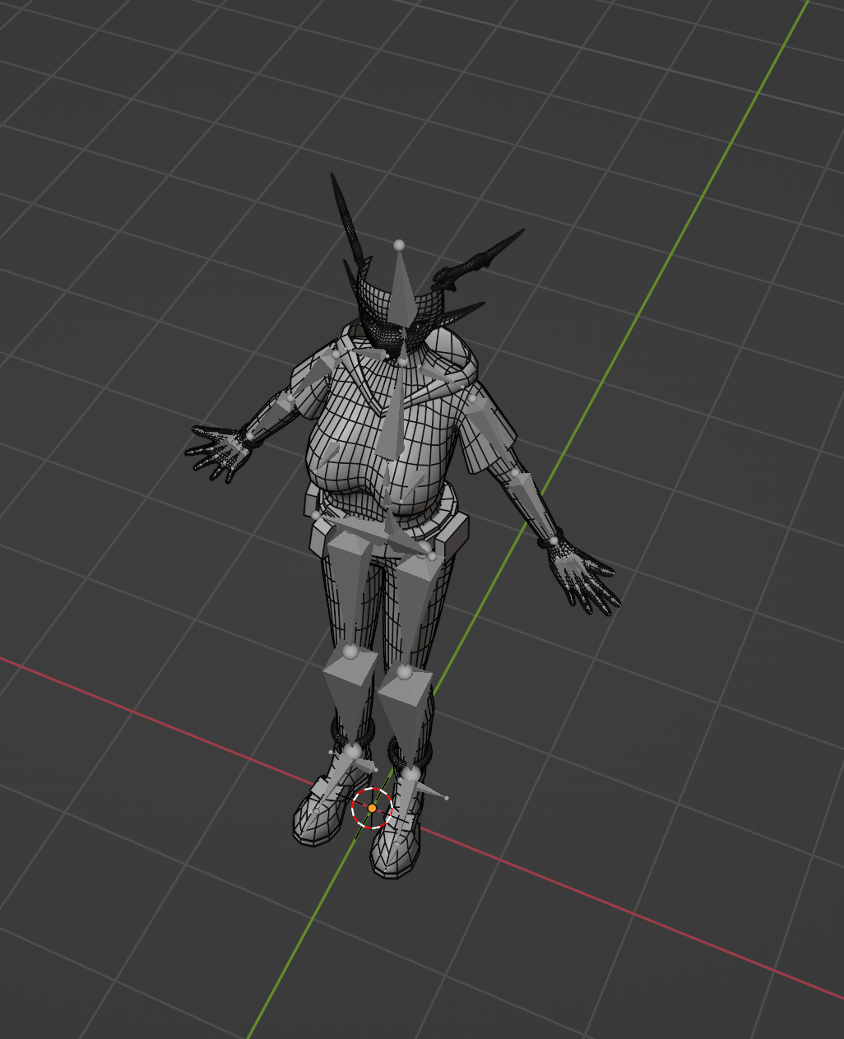
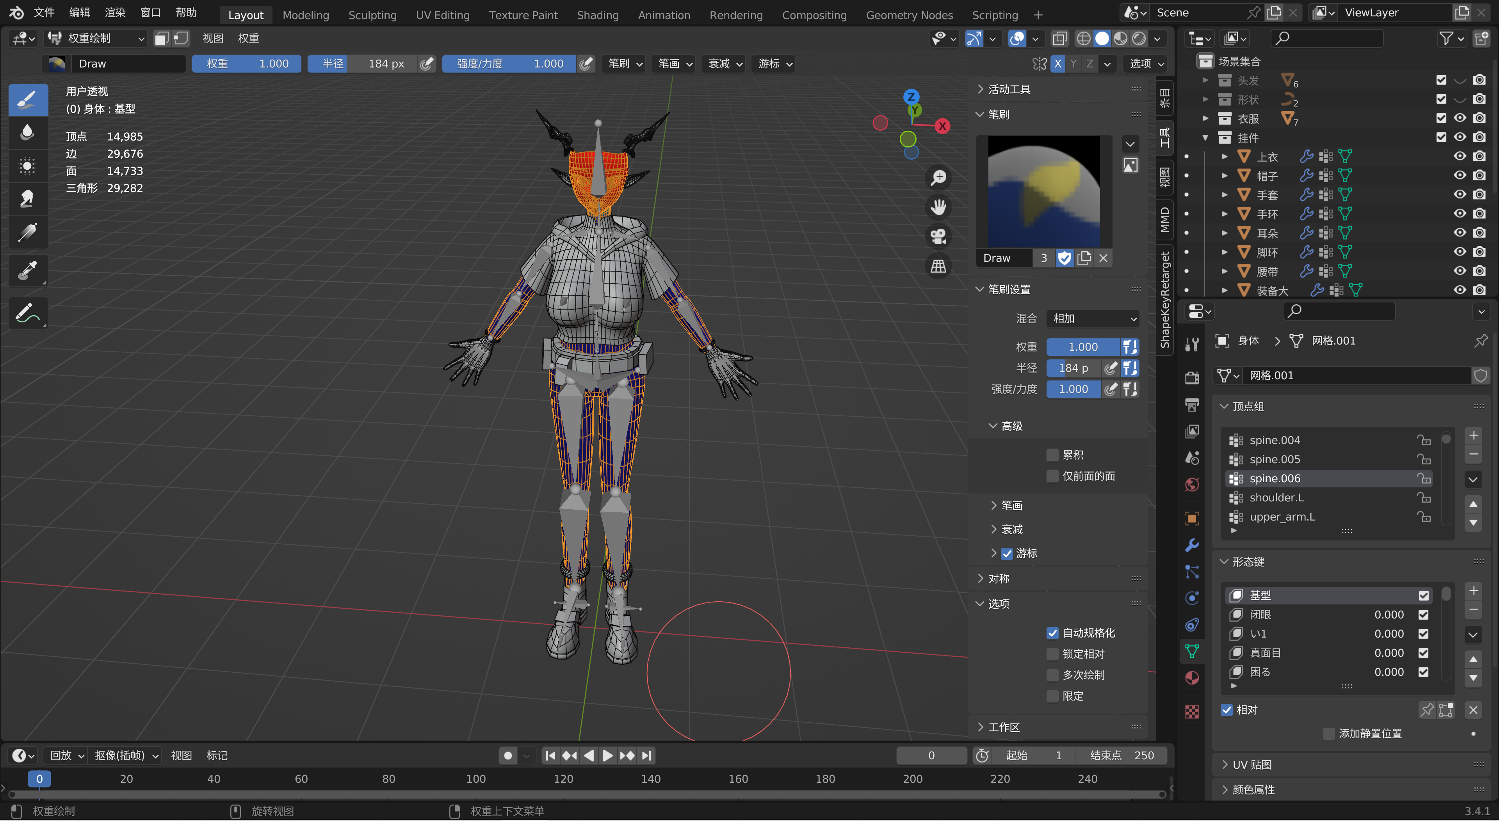
Motion Visualization
Character modeling
Vertex groups are assigned to bones for weight painting
Export the FBX into SP for texture painting.
The human skeleton is bound using a plugin based on Human (meta-rig), which includes more bones than required by SMPL, meeting our needs
Hair modeled using curves

Slide 14
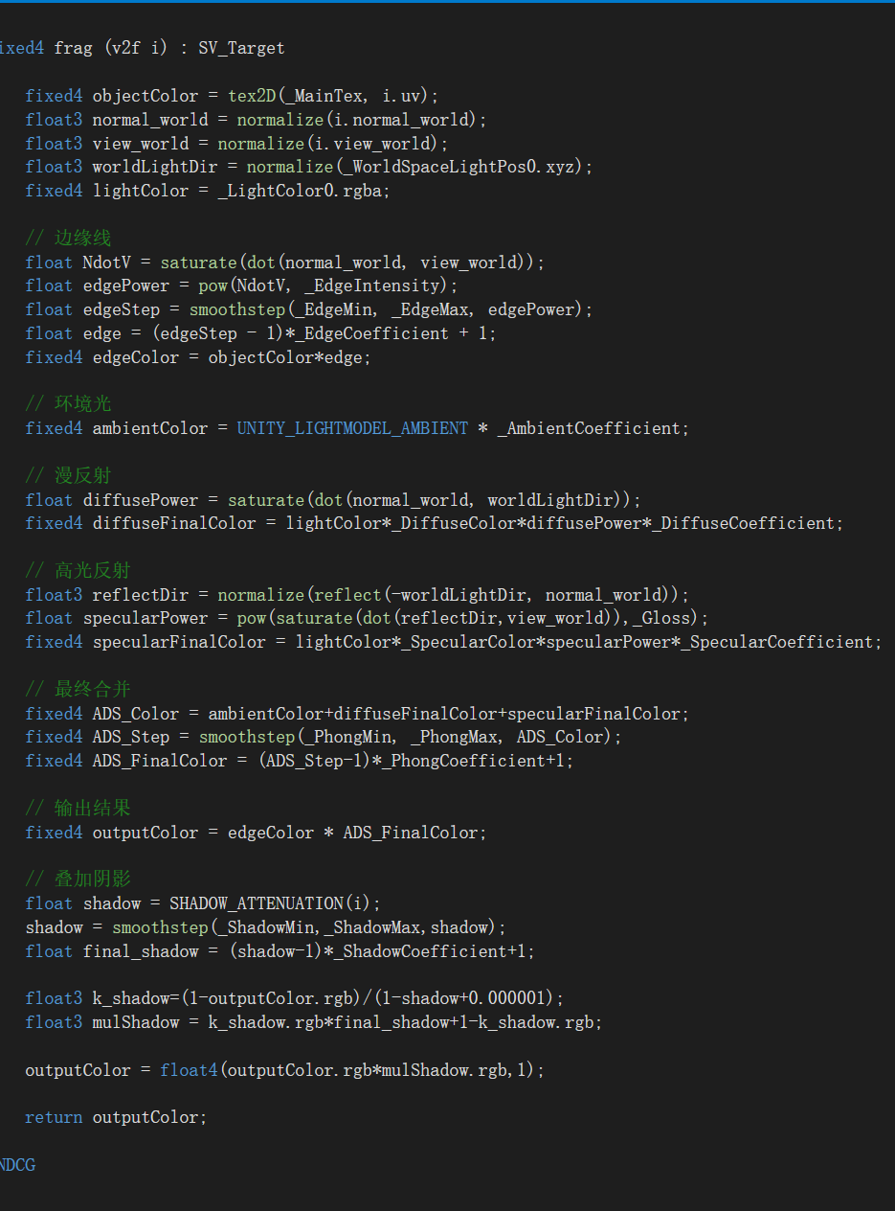
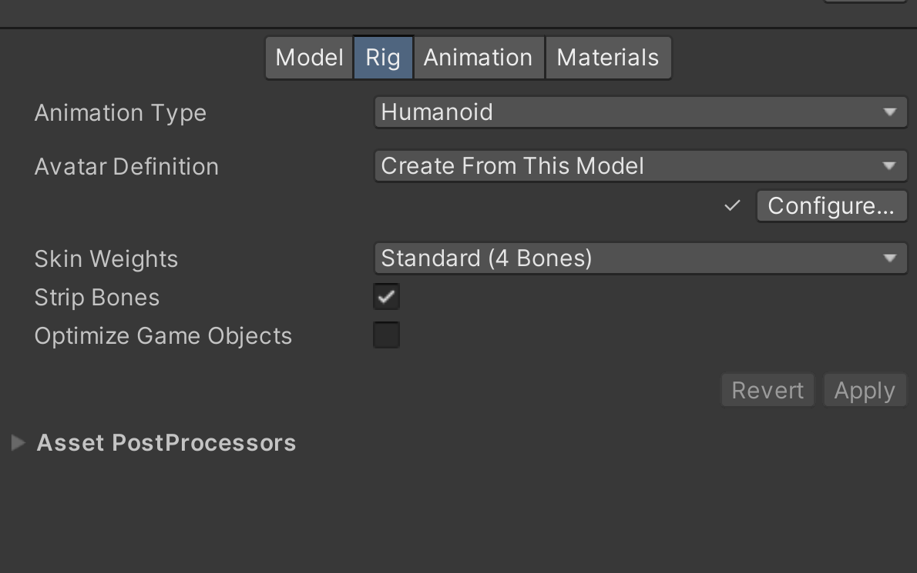
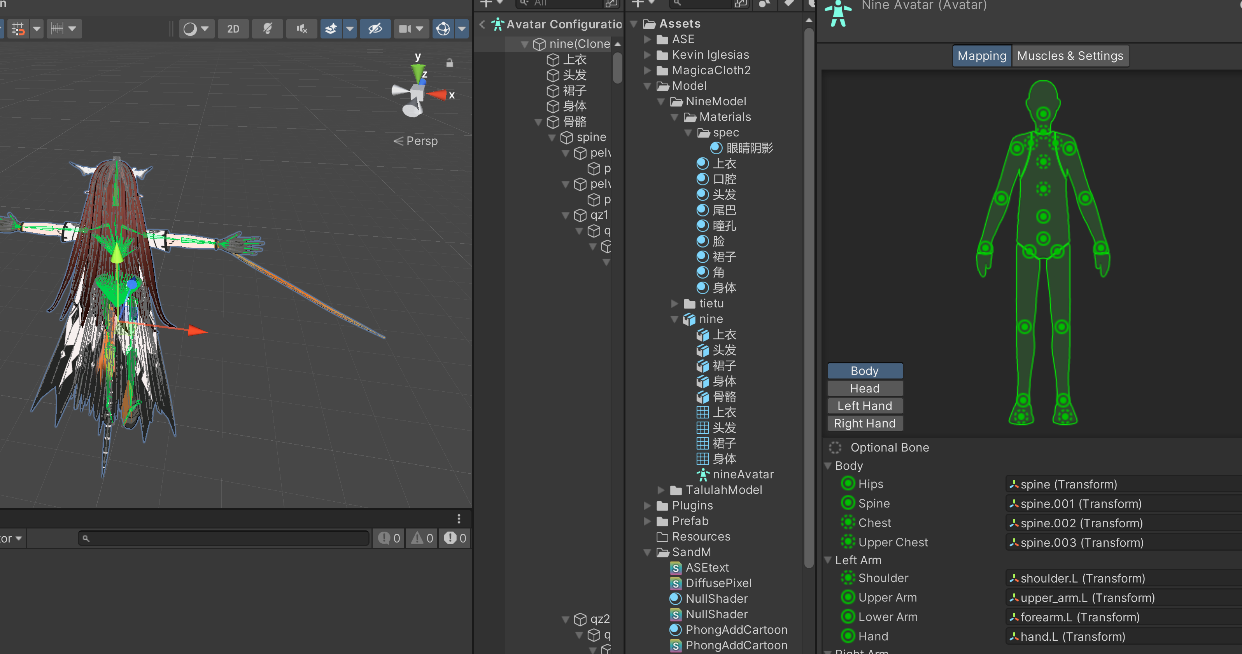
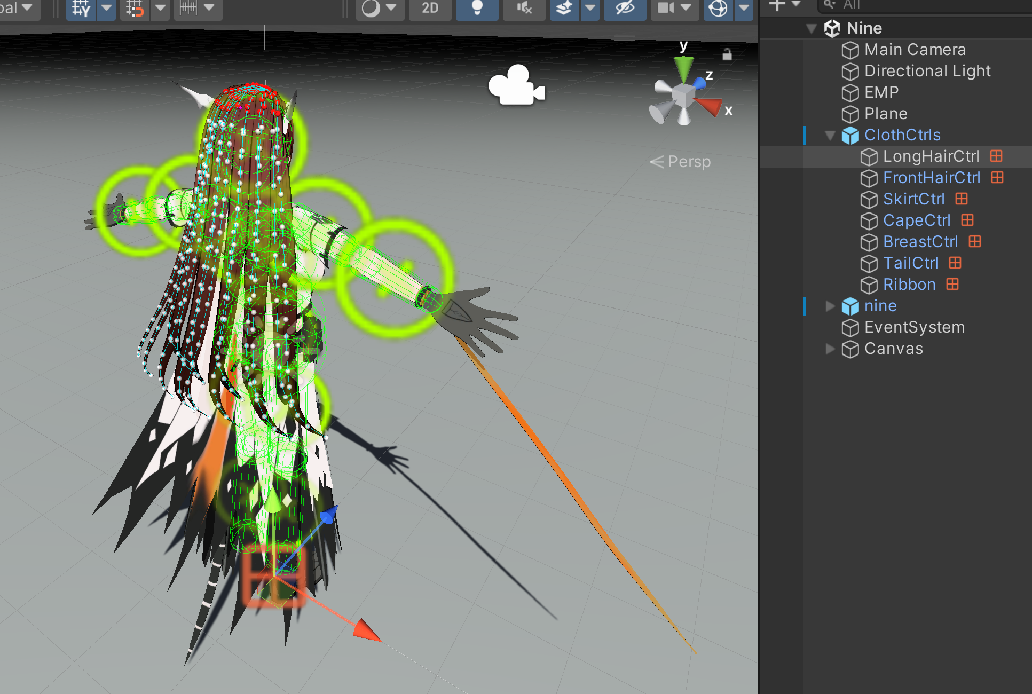
Motion Visualization
Character modeling
Rendering code
Skeletal matching
Use MagicaCloth2 to place the model into the scene, add cloth and hair physics effects, and add colliders.

Slide 15
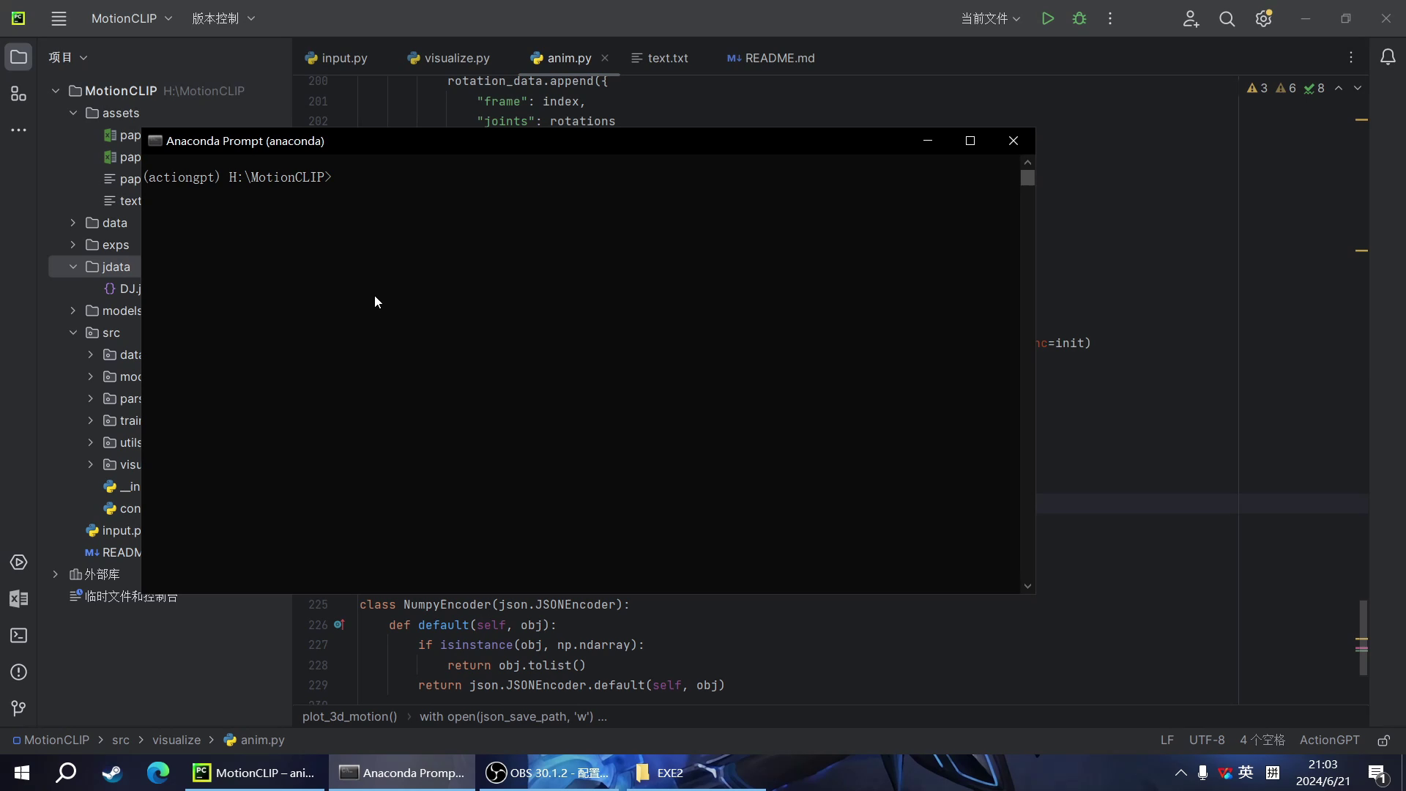
Demo Presentation

Slide 16
Conclusion
We introduced a motion generation network using CLIP to enable text-conditioned motion generation and editing. Training an auto-encoder solely on motion data struggled due to data quality or complexity. Aligning it with CLIP's latent space improved our understanding of motion and semantics.
CLIP's latent structure naturally induces semantics and disentanglement, even without motion data exposure. Our alignment strategy brings semantically similar motions closer and enhances disentanglement, shown by latent-space arithmetic experiments.
Using CLIP in motion generation improves interpretability and manipulation, aiding advanced graphics and animation applications.
Visualizing motion data helps in understanding and refining models like MotionCLIP and MotionDiffuse, allowing for performance assessment and anomaly detection through motion sequence analysis and comparison with ground truth.

Slide 17
Thanks

